Slide 1
Find out PNEUMONIA based on Chest X ray images by CNN of deep learning

Slide 2
Presented By:
Joy Das Shanta
id : 1402610200644
2. Tasfia Azim
id : 1402610200668

Slide 3
What is Pneumonia:
Pneumonia is an infection in one or both lungs.
It can be caused by bacteria, viruses, or fungi.
Bacterial pneumonia is the most common type in adults.
Pneumonia causes inflammation in the air sacs in your lungs, which are called alveoli. The alveoli fill with fluid or pus, making it difficult to breathe.

Slide 4
Why this:
1. Every year 1.9 million children under 5 years of age die from pneumonia.
2. Historically, pneumonia was the main cause of child death in developed countries, and in the United States in 1900, it is estimated that pneumonia killed 47 of every 1,000 children before the age of 5 years.
3. However, in the low-income countries of Asia and Africa, pneumonia is still the main cause of child death.

Slide 5
Why this:
Find out Pneumonia from X-ray images by a radiologist on begging stage is quite difficult and it’s need a lot of experience to detect it with accuracy.
Without finding this out in the very beginning stage it can be life-risking.
So we need to find this before it’s too late and with accuracy which is too difficult.

Slide 6
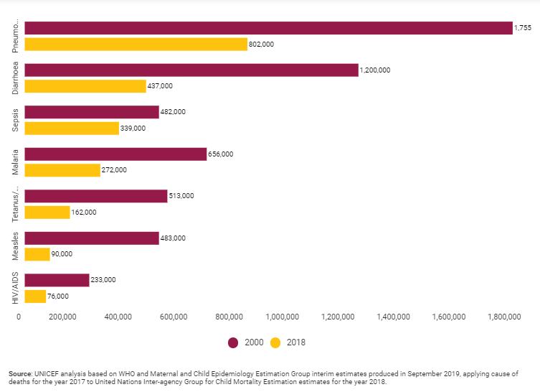
Why this:
A graph of child death rate by different disease:

Slide 7
About Dataset:
We have a open source dataset which downloaded from internet where we have total 5216 x-ray images files of almost 2945 persons.
Where 3875 images of 1945 persons who have pneumonia and 1341 images of normal x-ray images who don’t have pneumonia.

Slide 8
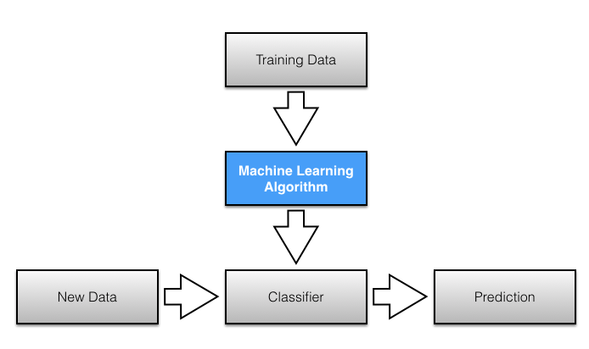
What method will we follow:
We will follow machine learning approach:

Slide 9
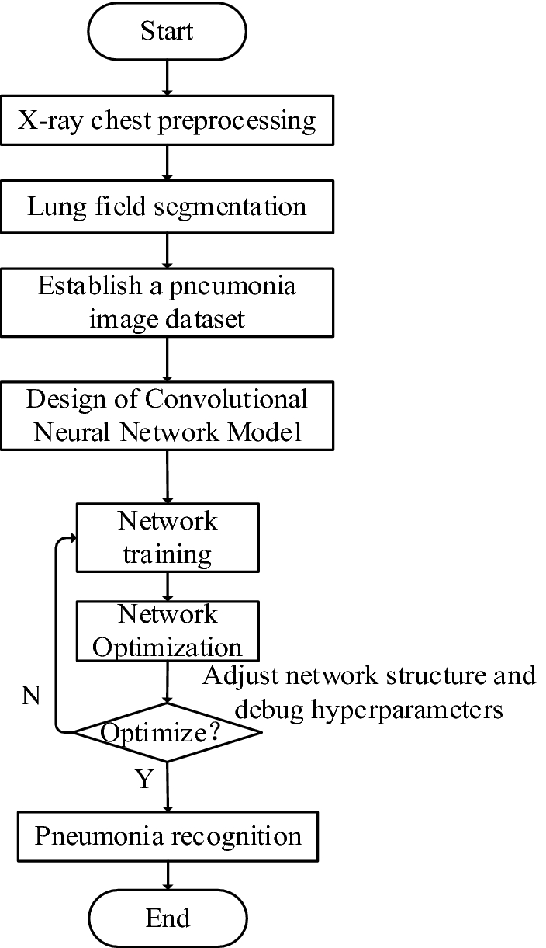
Predicated flow chart of our system

Slide 10
Details about flow chart:
1. X-ray Chest Pre-processing :
Though we have collected data from internet and different sources we have to make it feasible for analysis and to use in our system. Such as : labelling.
In simply, Raw data to clean dataset.

Slide 11
Details about flow chart:
Lung Field Segmentation:
Before detecting the objects and even before classify the image we will need to understand what the image consist of, what is called Image Segmentation.
There are mainly two types of image segmentations. They are:
1. Semantic Segmentation
2. Instance Segmentation

Slide 12
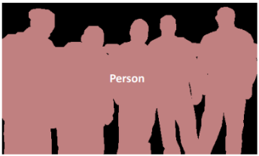
Details about flow chart:
In this image, every pixel belongs to a particular class (either background or person). Also, all the pixels belonging to a particular class are represented by the same colour (background as black and person as pink). This is an example of semantic segmentation.

Slide 13
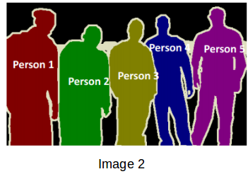
Details about flow chart:
In this image it has also assigned a particular class to each pixel of the image. However, different objects of the same class have different colors (Person 1 as red, Person 2 as green, background as black, etc.). This is an example of instance segmentation.

Slide 14
Details about flow chart:
Establish dataset:
Then we will stablish our dataset :
total 5216 x-ray images files
Pneumonia 3875 x-ray images files
Normal 1341 x-ray images files
in our system.

Slide 15
Details about flow chart:
Design of CNN :
Then we will design CNN network according to our needs.

Slide 16
Details about flow chart:
Train our system :
Then we will train our network by our training section of our dataset.

Slide 17
Details about flow chart:
Network Optimization:
We will adjust network structure and debug hyperparameters till get desired result.

Slide 18
Details about flow chart:
Pneumonia Recognition :
If we get desired result in doing optimization of our network then it is the end section of our system. The output result of the system will be either pneumonia or not.

Slide 19
End Section
Thank you.

